Slide 1
Predicting Message Paths and Conversation Intent
Notes:
Alice

Slide 2
HELLO!
Comm 100
Presentors:
Kristen Bystrom
Ye Liu
Alice Roberts
Ling Zhang
Qiang Zou
Wayne Ku
Nafis Abrar
Myung-chul Jeon
Tatchai Titichetrakun
Shyong Quin Yap
Rihan Yao
Notes:
Alice
We are working with the company named Comm 100
What is Comm100? It is an enterprise live chat for online customer support and sales.

Slide 3
Executive Summary
Introduction
Our Process
Our Results
Future Intentions
Summary
Executive Summary
Notes:
Alice

Slide 4
Introduction
1

Slide 5
Introduction
What is our goal?
Given a data set from Comm 100 we predicted the intent of conversations as well as clustered each message.
We also analyzed probability of conversation sentiment based on the clustering of the chat transcripts.

Slide 6
Our Data
What does our data look like?
We were provided with several data sets to work with:
Sample data includes 7,000 conversation transcripts. ( 1 transcript from each chat session.)
Full data includes 59,082 conversation transcripts.
The scripts consists of several languages including English and Mandarin.

Slide 7
[Agent]Brian - Comm100: Hello oguz, this is Brian. How can I help you?
[Visitor]oguz: hi brian
[Agent]Brian - Comm100: Hi
[Visitor]oguz: we have a problem about chat session
[Visitor]oguz: 2 or 3 customers connected same session
[Agent]Brian - Comm100: What seems to be the issue?
[Visitor]oguz: and customers chat together
[Agent]Brian - Comm100: Hi your colleague has reported this issue yesterday
[Visitor]oguz: yes Our members complain very much in this situation
[Agent]Brian - Comm100: It was because those users need to be separated.
[Agent]Brian - Comm100: I have reported to the developers
[Visitor]oguz: yes, your personel give this link https://betlive100.com/chatserver/chatwindow.aspx?planId=146&siteId=223641
[Agent]Brian - Comm100: And will let you know when fixed
[Agent]Brian - Comm100: Yes
[Visitor]oguz: thank you
[Agent]Brian - Comm100: you are welcome
[Visitor]: The visitor has left the chat.
Sample
Chat
Transcript

Slide 8
Our Process
2

Slide 9
What did we do?
Prepared Data
Pulled Data
Cleaned Data
Structured Data
Vectorized Features
Found statistics on the words
Extracted keywords by TFIDF
Attained sentiment by TEXTBLOB
Clustering
Refined keywords by LDA & K-Means
Performed NLP using spaCy
Notes:
Qiang:
we divided the whole task into three sequential modules:

Slide 10
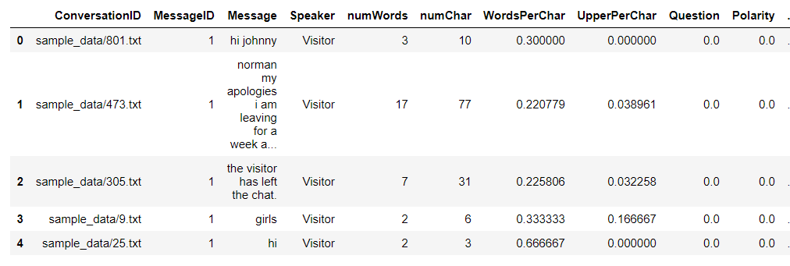
What did we do?
From Chat Logs to Pandas
Notes:
Kristen

Slide 11
Our Results
3
Notes:
Kristen

Slide 12
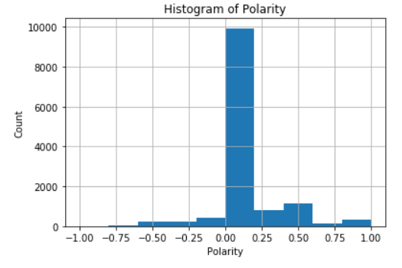
Our Results
Notes:
Kristen

Slide 13
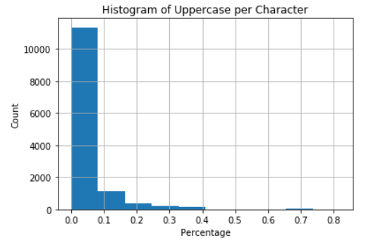
Our Results
Notes:
Kristen

Slide 14
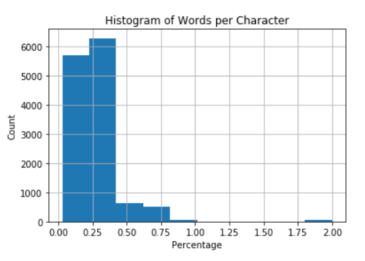
Our Results
Notes:
Kristen

Slide 15

Notes:
Leo

Slide 16
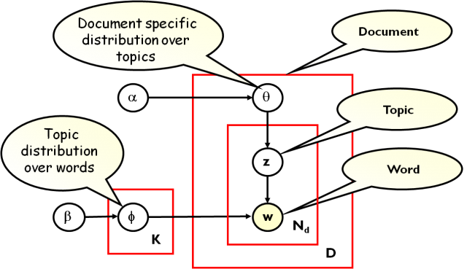
Latent Dirichlet Allocation (LDA) Model
Our Results
Notes:
Leo

Slide 17
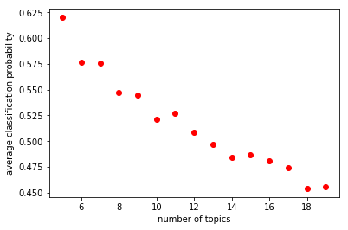
Our Results
Clustering Accuracy vs Number of Topics
Notes:
Leo

Slide 18
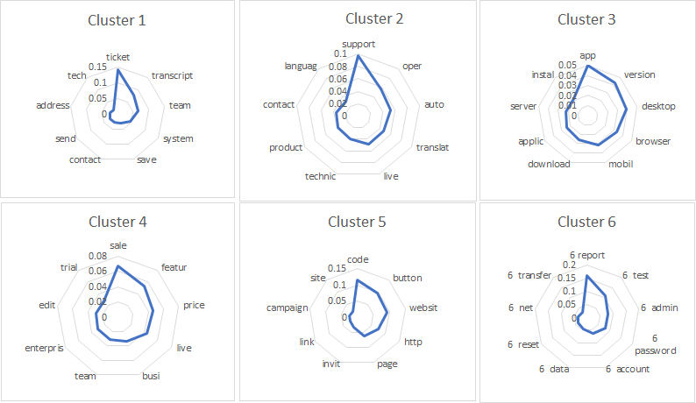
Our Results
Radar Charts of each Cluster
Notes:
Leo

Slide 19
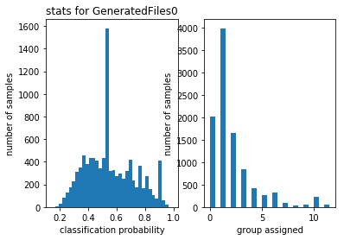
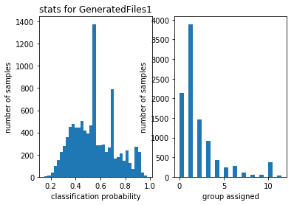
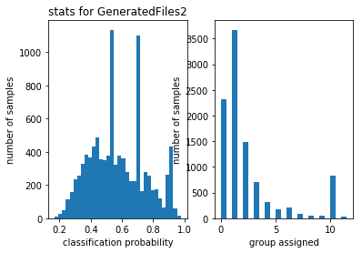
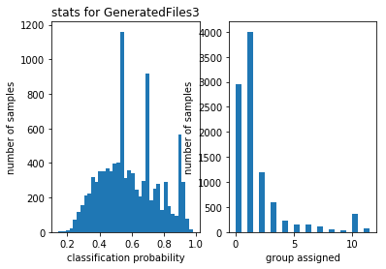
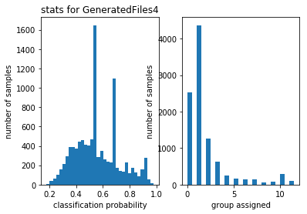
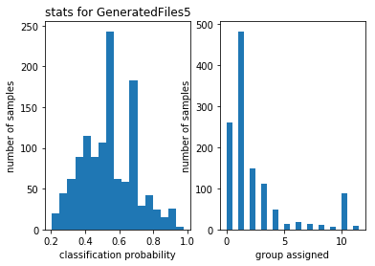
Our Results
Notes:
Leo

Slide 20

Our Results
Correlation of clustering distributions on 6 datasets
Notes:
Leo

Slide 21
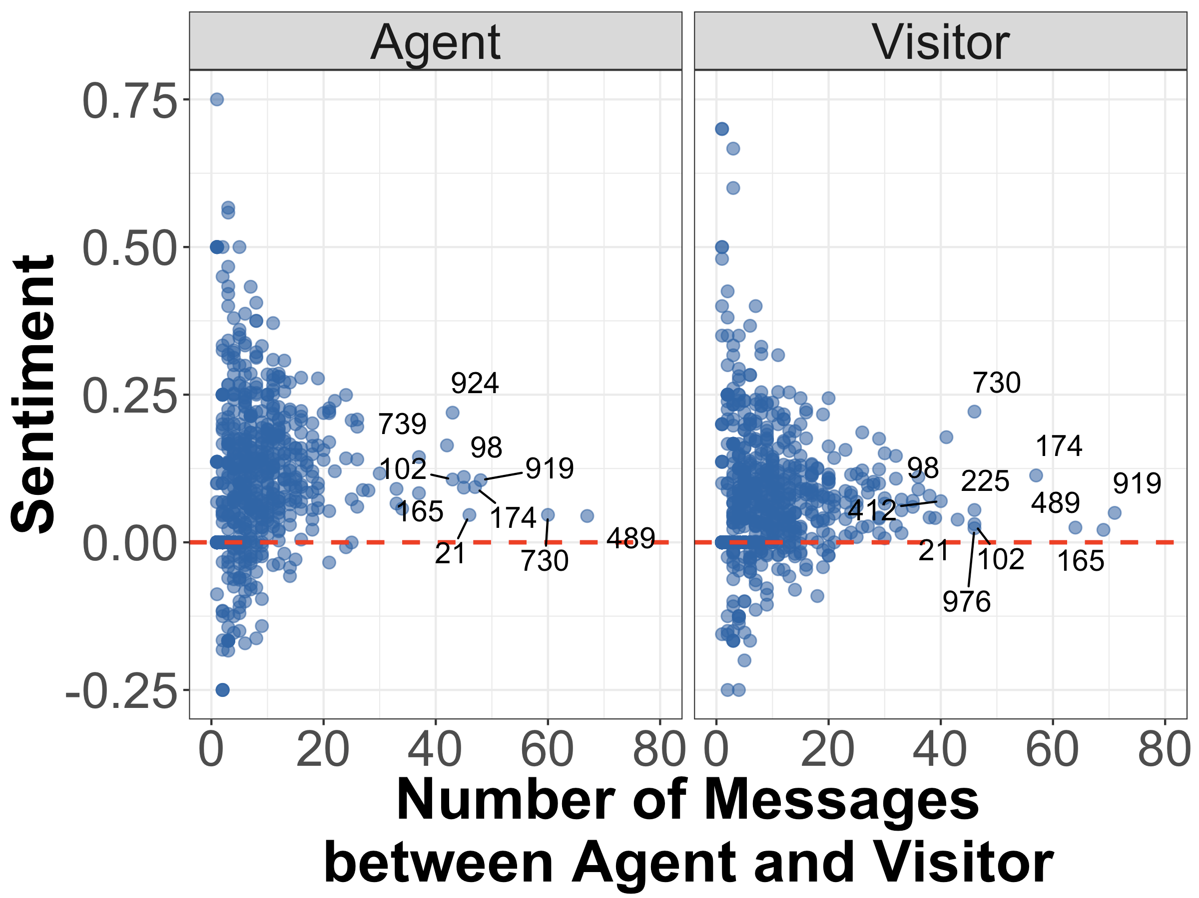
Data Visualization based on sentiment analysis
So, how positive is our interaction with the customers?
Notes:
Nafis/Eva
How the agents are performing
One of the purpose is to determine whether longer chats are correlated with negative sentiment
Every point is average polarity for either agent or visitor per chat session [speak about score system]
Points are labelled with conversation ID (i.e. chat session), showing chat sessions in which the agent/visitor sent over 40 or more messages

Slide 22
Future Intentions
4
Notes:
Kristen

Slide 23
What else can we do?
Markov Chain Message Modelling
1 2 3 4 5 6
Let state 1 be the first message of the conversation.
Let the final state be the last message in the conversation.
Let states 2-(n-1) be the clusters from our analysis.
Let P be the transition matrix of probabilities of transitioning between message states i and j.
0 pij pij pi pij pij
0 pij pij pij pij pij
0 pij pij pij pij pij
0 pij pij pij pij pij
0 pij pij pij pij pij
0 0 0 0 0 1
P =
1 2 3 4 5 6
Notes:
Kristen

Slide 24
What else can we do?
Markov Chain Message Modelling
1 2 3 4 5 6
Let state 1 be the first message of the conversation.
Let the final state be the last message in the conversation.
Let states 2-(n-1) be the clusters from our analysis.
Let P be the transition matrix of probabilities of transitioning between message states.
0 pij pij pi pij pij
0 pij pij pij pij pij
0 pij pij pij pij pij
0 pij pij pij pij pij
0 pij pij pij pij pij
0 0 0 0 0 1
P =
1 2 3 4 5 6
Notes:
Kristen

Slide 25
What else can we do?
Markov Chain Message Modelling
1 2 3 4 5 6
Let state 1 be the first message of the conversation.
Let the final state be the last message in the conversation.
Let states 2-(n-1) be the clusters from our analysis.
Let P be the transition matrix of probabilities of transitioning between message states.
0 pij pij pi pij pij
0 pij pij pij pij pij
0 pij pij pij pij pij
0 pij pij pij pij pij
0 pij pij pij pij pij
0 0 0 0 0 1
P =
1 2 3 4 5 6
Notes:
Kristen

Slide 26
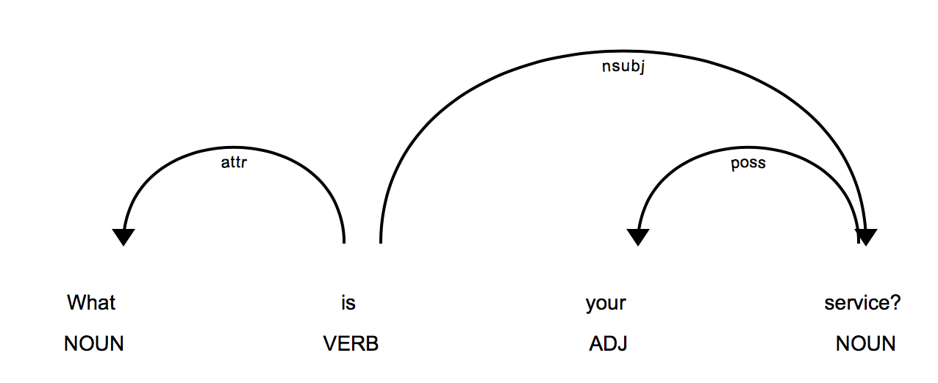
What else can we do?
Sentiment Analysis
Text interpretation using SpaCy
Identifying sentences.
Identifying the interdependencies between the words.
Rasa NLU trainer based on SpaCy and Scikit-Learn
Determine intent of a particular sentence.
Associating intent with entities and values
“Can I take a price for comm100 for 8 user?”
Intent: Inquiry (confidence)
Entity: Purchase
Value: Price
Input: “Can I take a price for comm100 for 8 user?”
Intent: Inquiry (confidence)
Entity: Purchase
Value: Price
Notes:
Wayne Ku

Slide 27
Work in Progress
Determining the intent of conversations based on sentiment analysis
What is the main cause of negative interactions in the transcript?
What similarities or keywords do the positive and negative messages have in common?
Improve services based on the features that most people are complaining about.
Notes:
Nafis
-Using nlp library to determine what is similar in negative chat sessions.What are people complainign about
-Comm 100 can work on those issues

Slide 28
A Better Chatbot?
Context Specific
Give the right answer
Starting with identifying the topic
Notes:
Ling Zhang

Slide 29
Level 1 Categories
By
Topics of Conversations
Setup & Getting Started
Settings & Customizations
Monitor & Chat
Transcripts & Reports
Billing & Management
Desktop & Mobile Apps
API & Webhooks
Troubleshooting
Notes:
Ling Zhang

Slide 30
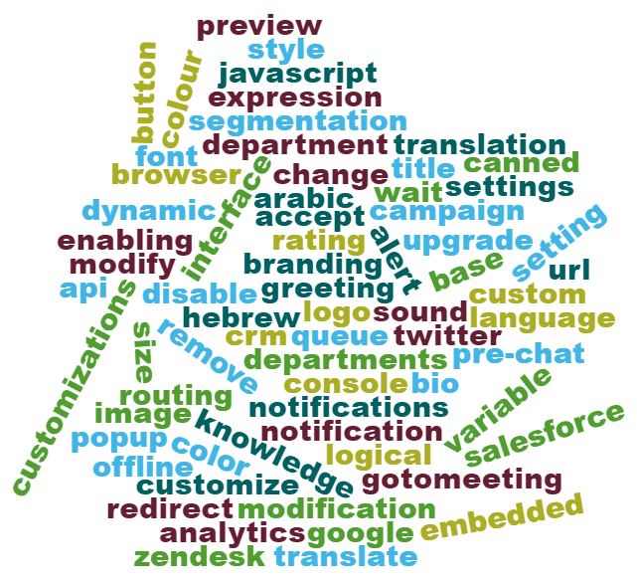
Settings & Customization Keywords
Notes:
Ling Zhang

Slide 31
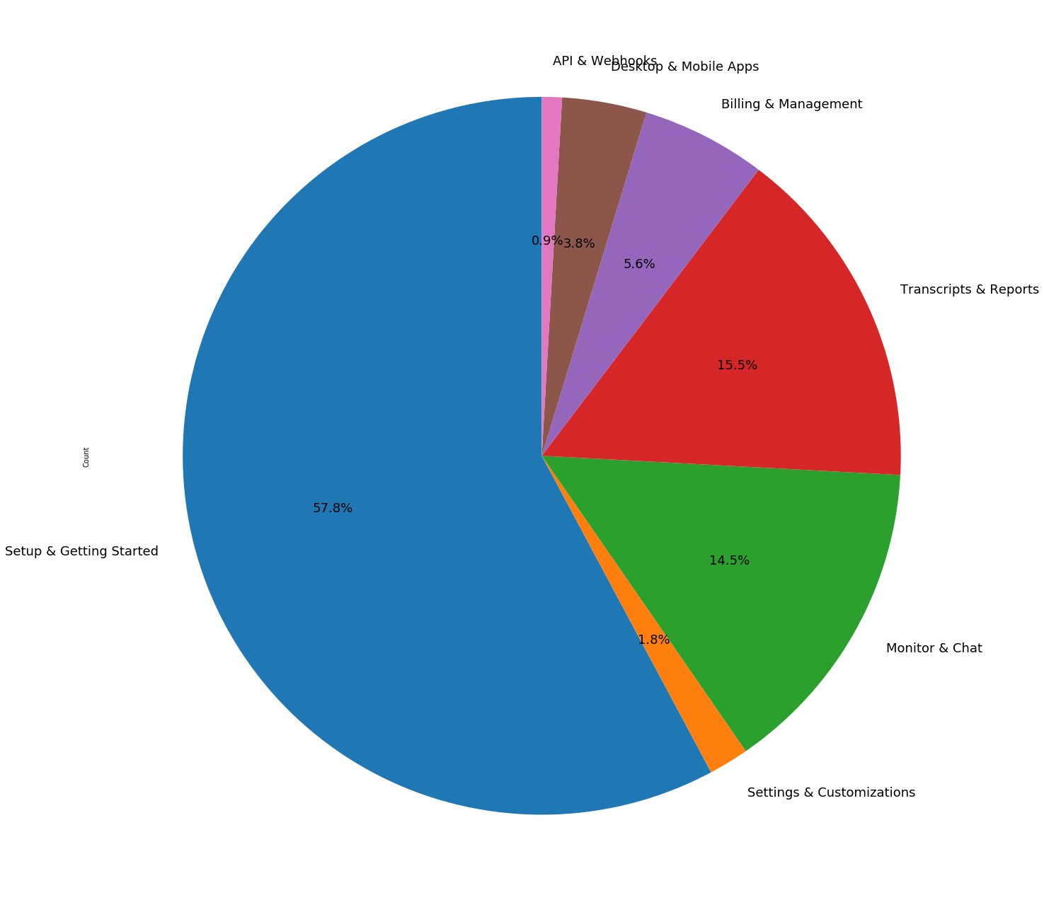
Results
API & Webhooks
Desktop & Mobile Apps
Billing & Management
Transcripts & Reports
Setup & Getting Started
Monitor & Chat
Settings & Customizations
Notes:
Ling Zhang

Slide 32
Next Steps?
Additional Sub-categories
Integration With Knowledge Base
Chatbot Development
Notes:
Ling Zhang

Slide 33
Summary
5

Slide 34
Predicting Message Paths and Conversation Intent

